Slide 1
Introduction to Computers
What is a Computer?

Slide 2
a brief history of computers.
hardware and software make up computer architecture.
the binary representation of data and programs in computers.
Discuss the evolution of programming languages.
Describe the software development process.
Discuss the fundamental concepts of object-oriented programming.

Slide 3
What Is A Computer?
A computer is an electronic device, operating under the control of instructions (software) stored in its own memory unit, that can accept data (input), manipulate data (process), and produce information (output) from the processing.
Computer is an Electronic Data Processing Device

Slide 4
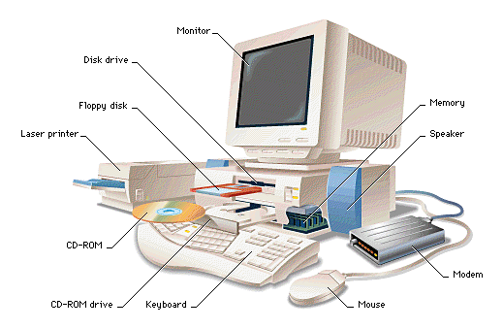
Components in a computer system

Slide 5
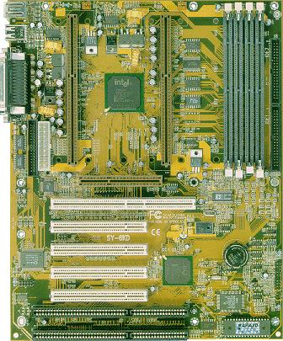
Motherboard

Slide 6
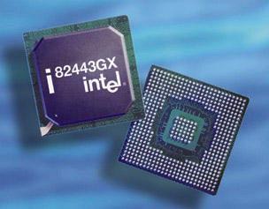
CPU
(Central Processing Unit)

Slide 7
Ports
bus
Printer
Mouse
Keyboard
Modem
Disk
controller
Graphics
card
Monitor
Speakers
CPU
Sound
card
RAM
Network
card
Computer

Slide 8
What Does A Computer Do?
Computers can perform four general operations, which comprise the information processing cycle.
Input
Process
Output
Storage

Slide 9
Data and Information
All computer processing requires data, which is a collection of raw facts, figures and symbols, such as numbers, words, images, video and sound, given to the computer during the input phase.
Computers manipulate data to create information. Information is data that is organized, meaningful, and useful.
During the output Phase, the information that has been created is put into some form, such as a printed report.
The information can also be put in computer storage for future use.

Slide 10
Why Is A Computer So Powerful?
The ability to perform the information processing cycle with amazing speed.
Reliability (low failure rate).
Accuracy.
Ability to store huge amounts of data and information.
Ability to communicate with other computers.

Slide 11
How Does a Computer Know what to do?
It must be given a detailed list of instructions, called a compute program or software, that tells it exactly what to do.
Before processing a specific job, the computer program corresponding to that job must be stored in memory.
Once the program is stored in memory the compute can start the operation by executing the program instructions one after the other.

Slide 12
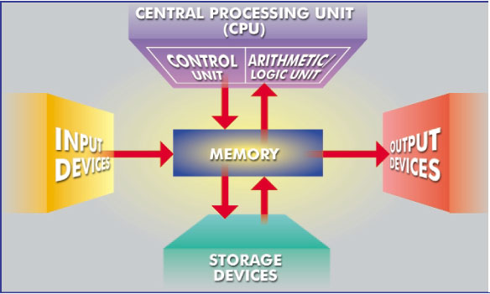
What Are The Primary Components Of A Computer ?
Input devices.
Central Processing Unit (containing the control unit and the arithmetic/logic unit).
Memory.
Output devices.
Storage devices.

Slide 13
Input Devices
Keyboard.
Mouse.

Slide 14
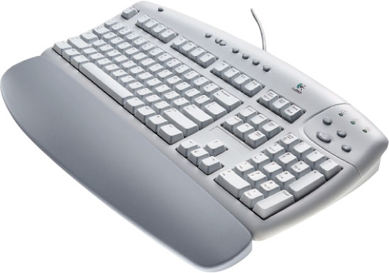
The Keyboard
The most commonly used input device is the keyboard on which data is entered by manually keying in or typing certain keys. A keyboard typically has 101 or 105 keys.

Slide 15
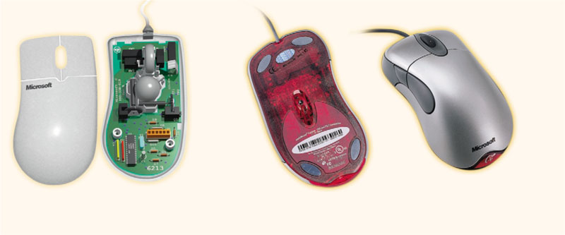
The Mouse
Is a pointing device which is used to control the movement of a mouse pointer on the screen to make selections from the screen. A mouse has one to five buttons. The bottom of the mouse is flat and contains a mechanism that detects movement of the mouse.

Slide 16
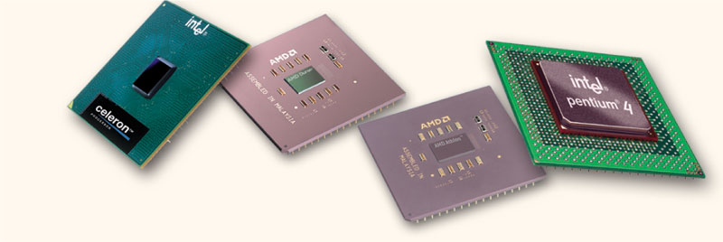
The Central processing Unit
The central processing unit (CPU) contains electronic circuits that cause processing to occur. The CPU interprets instructions to the computer, performs the logical and arithmetic processing operations, and causes the input and output operations to occur. It is considered the “brain” of the computer.

Slide 17
Memory
Memory also called Random Access Memory or RAM (temporary memory) is the main memory of the computer. It consists of electronic components that store data including numbers, letters of the alphabet, graphics and sound. Any information stored in RAM is lost when the computer is turned off.
Read Only Memory or ROM is memory that is etched on a chip that has start-up directions for your computer. It is permanent memory.

Slide 18
Amount Of RAM In Computers
The amount of memory in computers is typically measured in kilobytes or megabytes. One kilobyte (K or KB) equals approximately 1,000 memory locations and one megabyte (M or MB) equals approximately one million locations A memory location, or byte, usually stores one character.
Therefore, a computer with 8 MB of memory can store approximately 8 million characters. One megabyte can hold approximately 500 pages of text information.

Slide 19
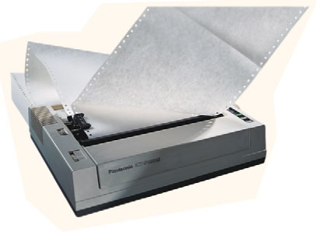
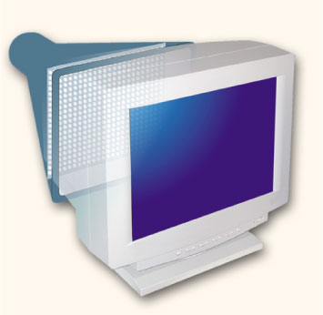
Output Devices
Output devices make the information resulting from the processing available for use. The two output devices more commonly used are the printer and the computer screen.
The printer produces a hard copy of your output, and the computer screen produces a soft copy of your output.

Slide 20
Storage Devices
Auxiliary storage devices are used to store data when they are not being used in memory.
The most common types of auxiliary storage used on personal computers are floppy disks, hard disks and CD-ROM drives.

Slide 21
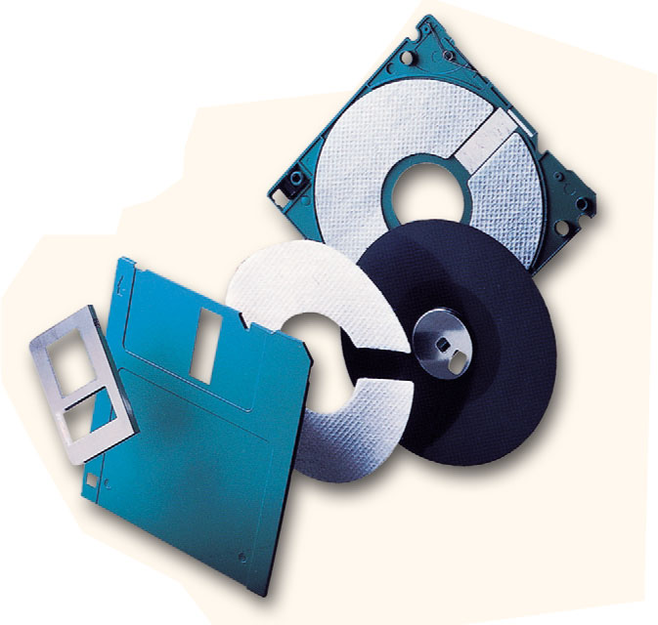
Floppy Disks
A floppy disk is a portable, inexpensive storage medium that consists of a thin, circular, flexible plastic disk with a magnetic coating enclosed in a square-shaped plastic shell.

Slide 22
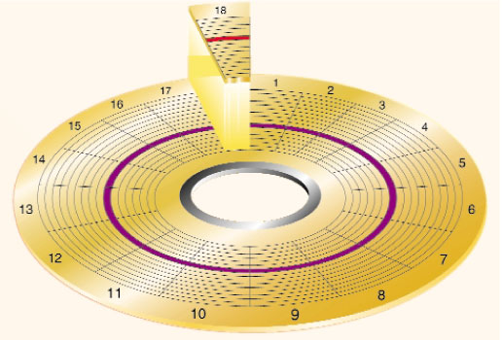
The disk’s storage locations are divided into pie-shaped sections called sectors.
A sectors is capable of holding 512 bytes of data.
A typical floppy stores data on both sides and has 80 tracks on each side with 18 sectors per track.

Slide 23
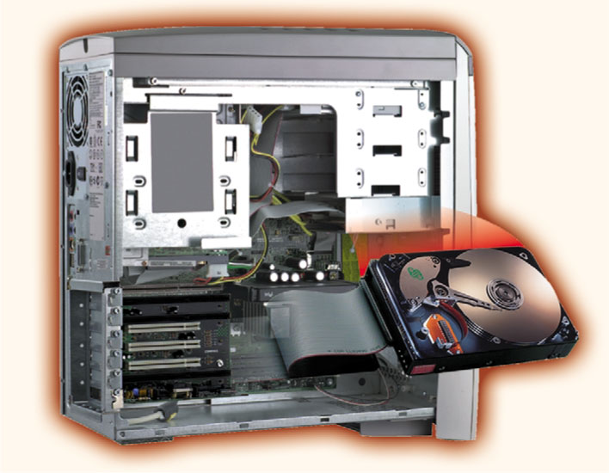
Hard Disks
Another form of auxiliary storage is a hard disk. A hard disk consists of one or more rigid metal plates coated with a metal oxide material that allows data to be magnetically recorded on the surface of the platters.
The hard disk platters spin at a high rate of speed, typically 5400 to 7200 revolutions per minute (RPM).
Storage capacities of hard disks for personal computers range from 10 GB to 120 GB (one billion bytes are called a gigabyte).

Slide 24
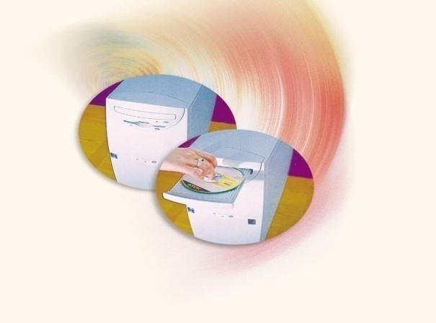
Compact Discs
A compact disk (CD), also called an optical disc, is a flat round, portable storage medium that is usually 4.75 inch in diameter.
A CD-ROM (read only memory), is a compact disc that used the same laser technology as audio CDs for recording music. In addition it can contain other types of data such as text, graphics, and video.
The capacity of a CD-ROM is 650 MB of data.

Slide 25
Computer Software
Computer software is the key to productive use of computers. Software can be categorized into two types:
Operating System Software
Application Software.

Slide 26
Operating System Software
Operating system software tells the computer how to perform the functions of loading, storing and executing an application and how to transfer data.
Today, many computers use an operating system that has a graphical user interface (GUI) that provides visual clues such as icon symbols to help the user. Microsoft Windowsis a widely used graphical operating system. DOS (Disk Operating System) is an older but still widely used operating system that is text-based.

Slide 27
More Operating Systems?
https://en.wikipedia.org/wiki/History_of_operating_systems

Slide 28
Application Software
Application Software consists of programs that tell a computer how to produce information. Some of the more commonly used packages are:
Word processing
Electronic spreadsheet
Database
Presentation graphics

Slide 29
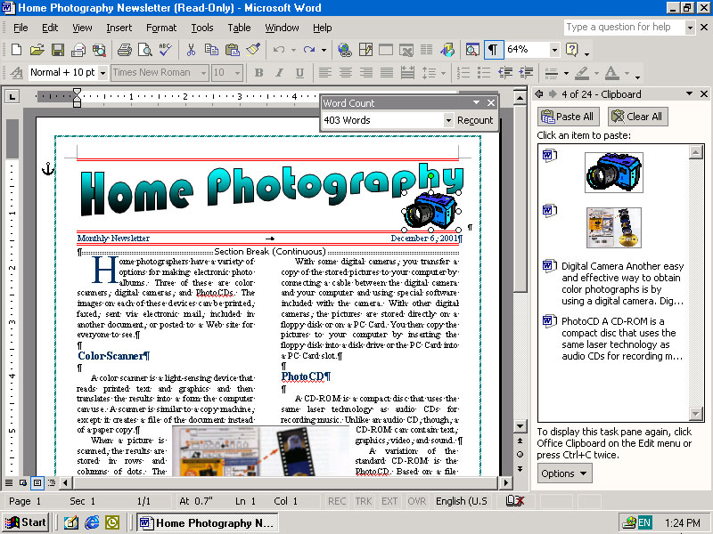
Word Processing
Word Processing software is used to create and print documents. A key advantage of word processing software is that users easily can make changes in documents.

Slide 30
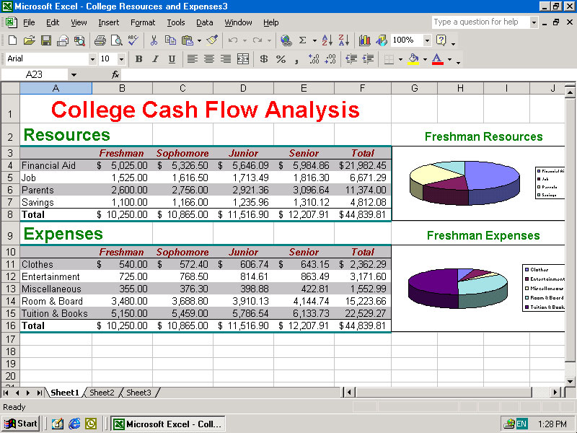
Electronic Spreadsheets
Electronic spreadsheet software allows the user to add, subtract, and perform user-defined calculations on rows and columns of numbers. These numbers can be changed and the spreadsheet quickly recalculates the new results.

Slide 31
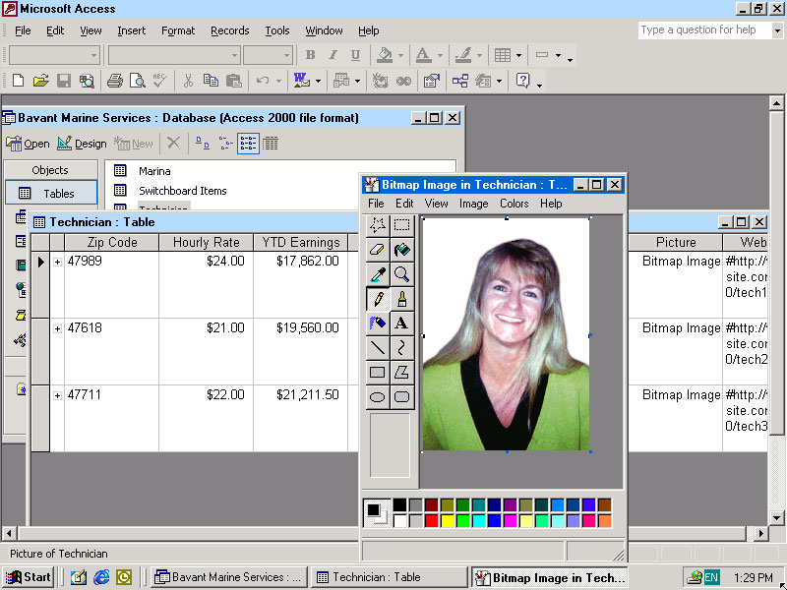
Database Software
Allows the user to enter, retrieve, and update data in an organized and efficient manner, with flexible inquiry and reporting capabilities.

Slide 32
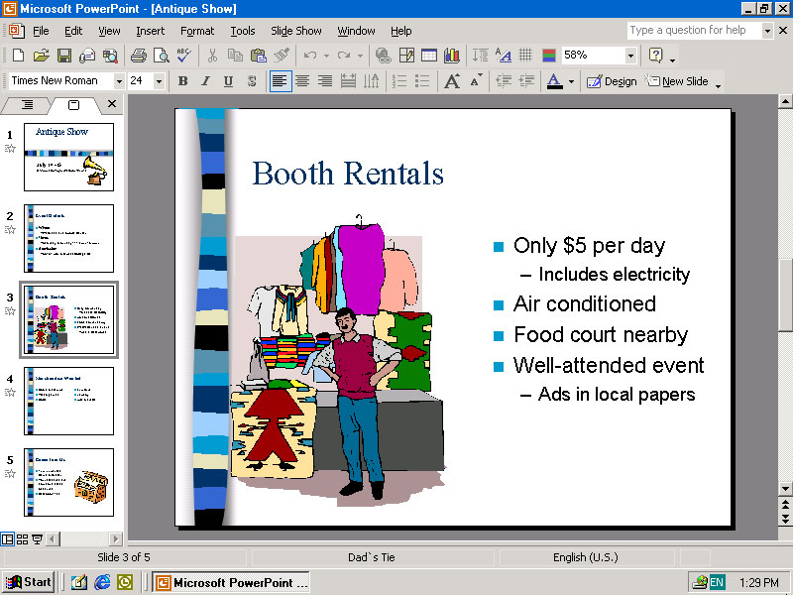
Presentation Graphics
Presentation graphic software allows the user to create documents called slides to be used in making the presentations. Using special projection devices, the slides display as they appear on the computer screen.

Slide 33

Chapter1 Key Terms

Slide 34
What kind of computer supports several users simultaneously while giving each person the illusion that he or she “owns” the computer?
A. PC
B. hand-held calculator
C. time-sharing computer

Slide 35
True or False? Secondary memory typically has a much greater storage capacity than primary memory.
True or False? Word processors translate programs to executable form.

Slide 36
A ___________ consists of 8 adjacent bits
The ___________ does the work of the computer.

Slide 37
Spreadsheets are examples of ___________ software.
Can you dentify as many examples of each of the six major subsystems as possible?

Slide 38
Which of the following is an example of a high-level language?
A. assembly language
B. machine language
C. Java

Slide 39
A(n) ___________ translates a program in a high-level language to machine code.
Java is a ___________ generation programming language.
Answer: third

Slide 40
https://en.wikipedia.org/wiki/First-generation_programming_language

Slide 41
Which of the following is the most costly part of the software life cycle?
A. design
B. coding
C. testing
D. maintenance

Slide 42
__________ is the part of the software development process wherein the programmers write the program code.

Slide 43
Objects in an object-oriented system provide services by running ___________.
A. classes
B. methods

Slide 44
A(n) ___________ defines data resources and behavior for a set of objects.
A(n) ___________ is a rule of behavior.

Slide 45
Homework1:
Exercise 1.2, 1.3, 1.4, 1.5, 1.6
P29 Review the question, fill in the blank
Page 30 project 1-1
Homework due Wednesday 8/23

Slide 46

Binary Number System

